Slide 1


Slide 2
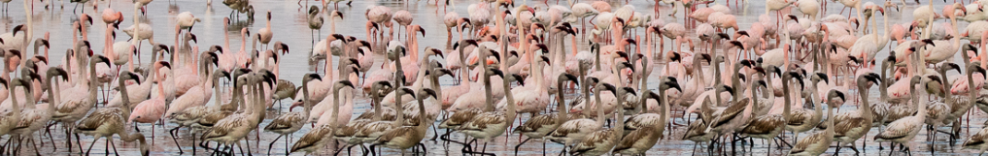




Delivering policy-relevant indicators:
South Africa’s Biodiversity Data Pipeline for Wetlands and Waterbirds
Francisco Cervantes, Stojanov, Y., Strobbe, F., Brooks, M., Altwegg, R.
International Statistical Ecology Conference 2022
Cape Town, South Africa

Slide 3
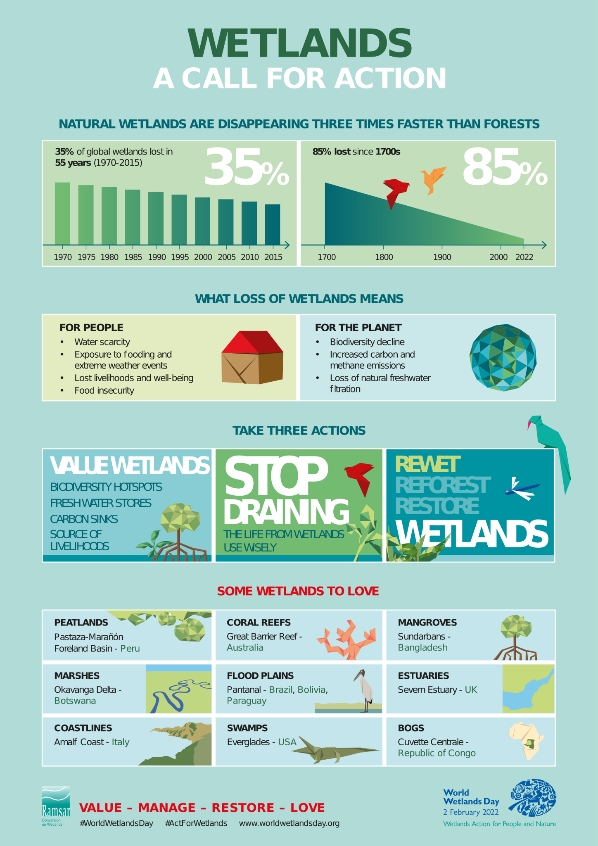


Slide 4
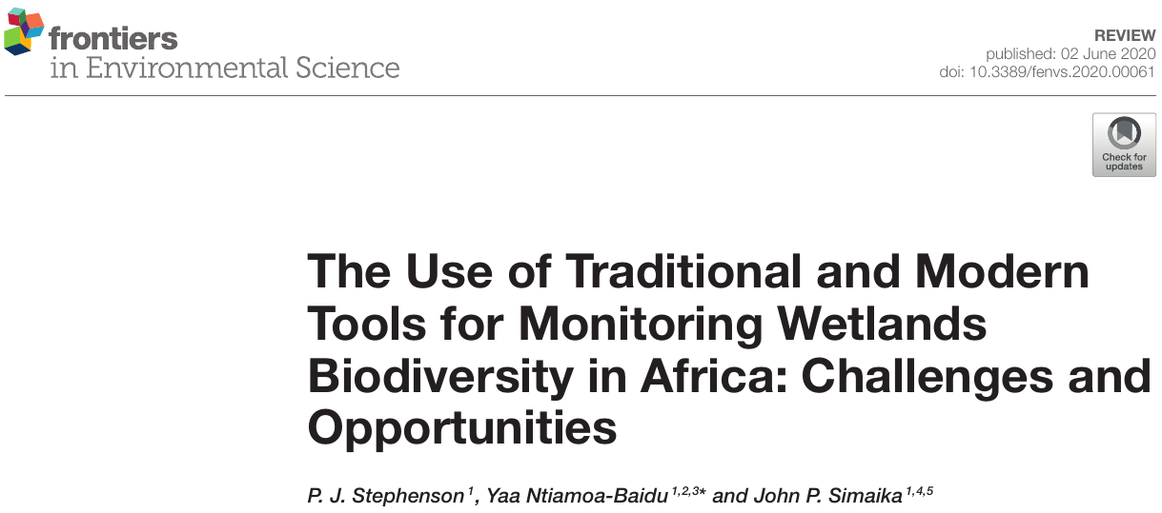

Slide 5


Southern African Bird Atlas Project
Coordinated Waterbird Counts

Slide 6
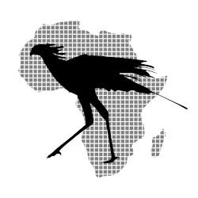
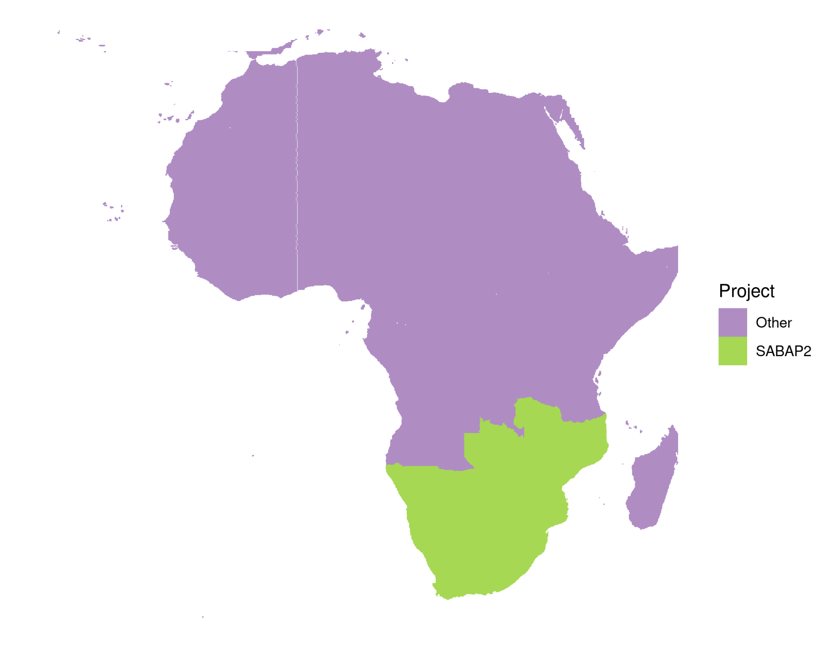
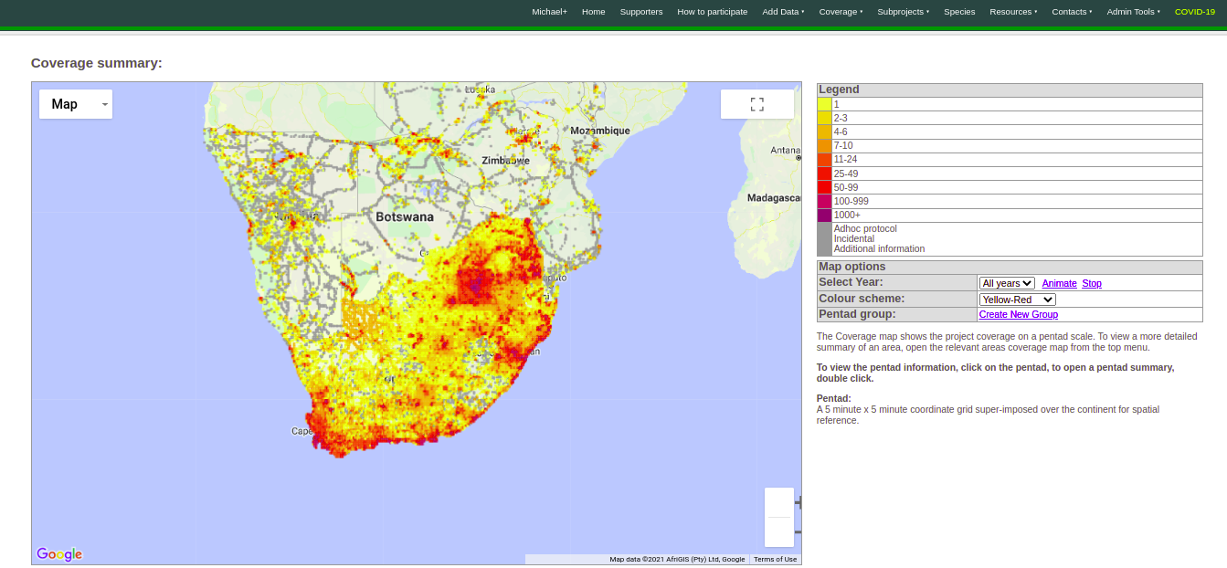
Southern African Bird Atlas Project
2007-ongoing
Detection/non-detection
~17.6 million records
14061 of 16708 pentads (5’ x 5’)

Slide 7
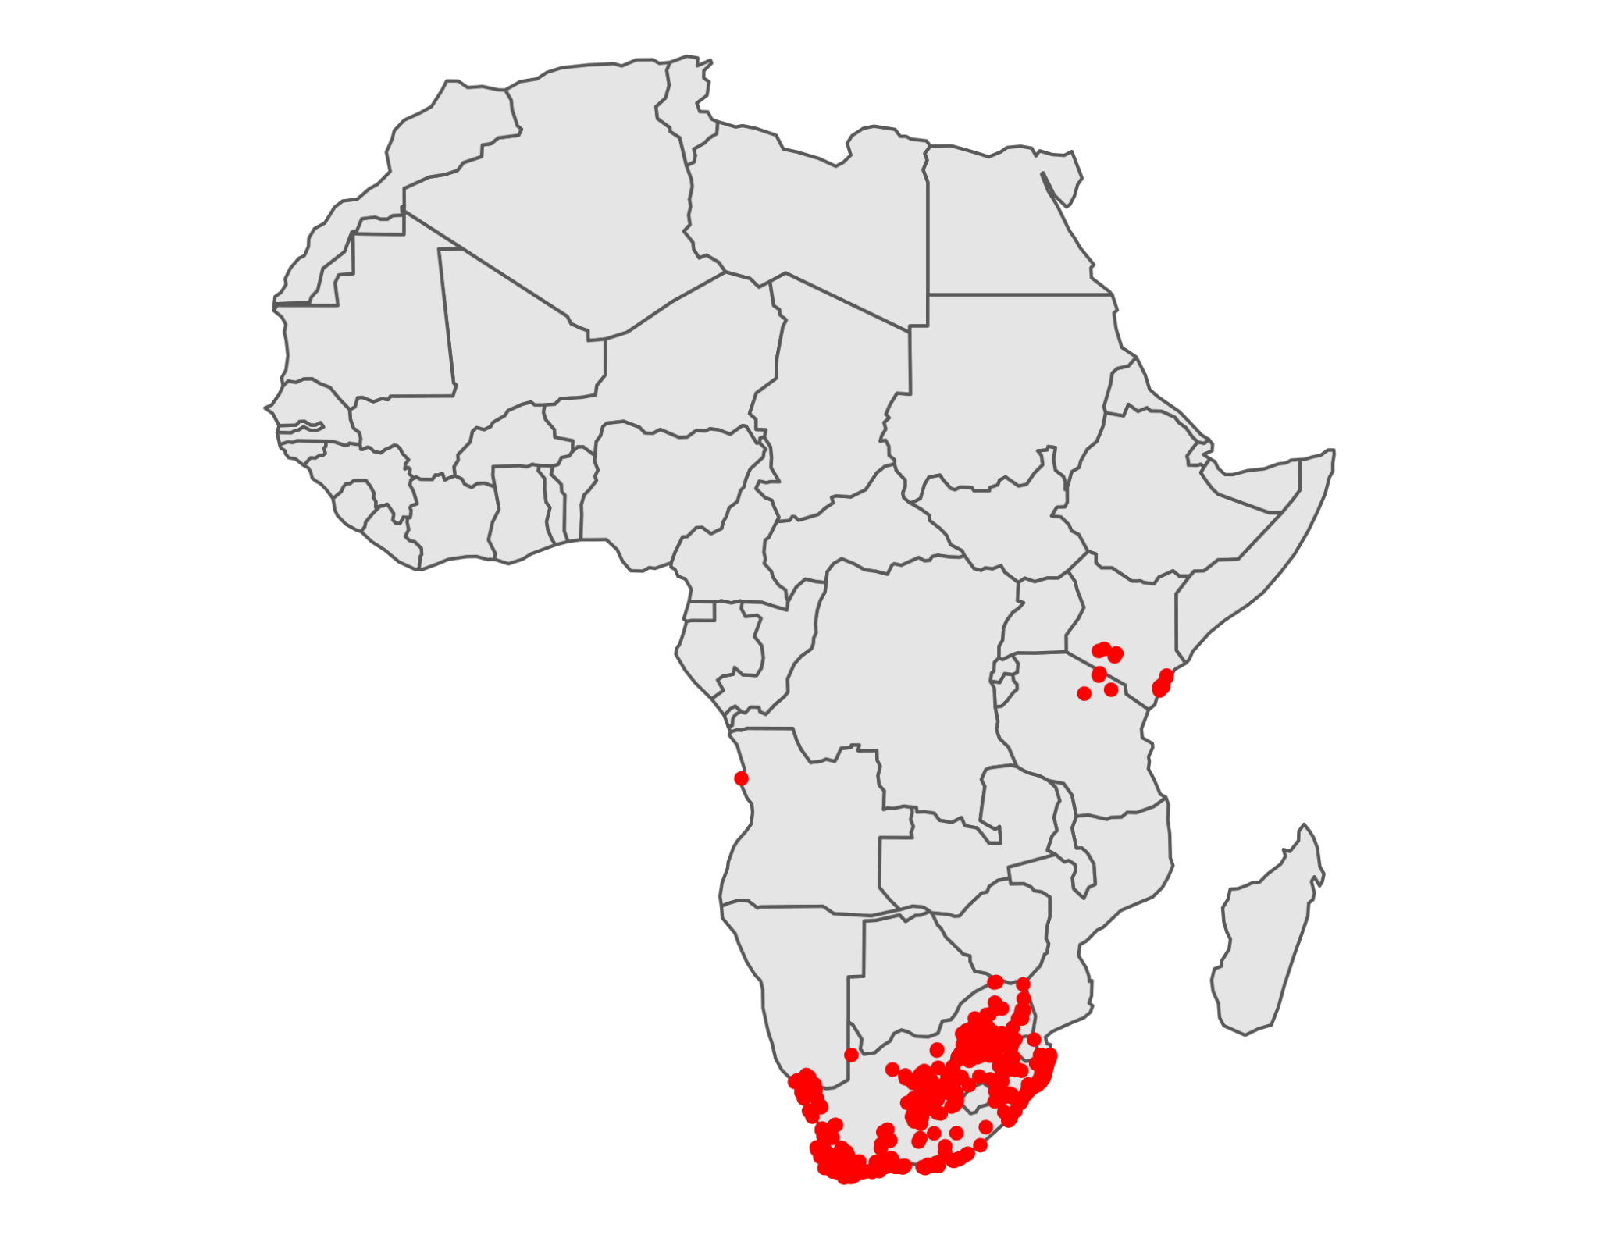
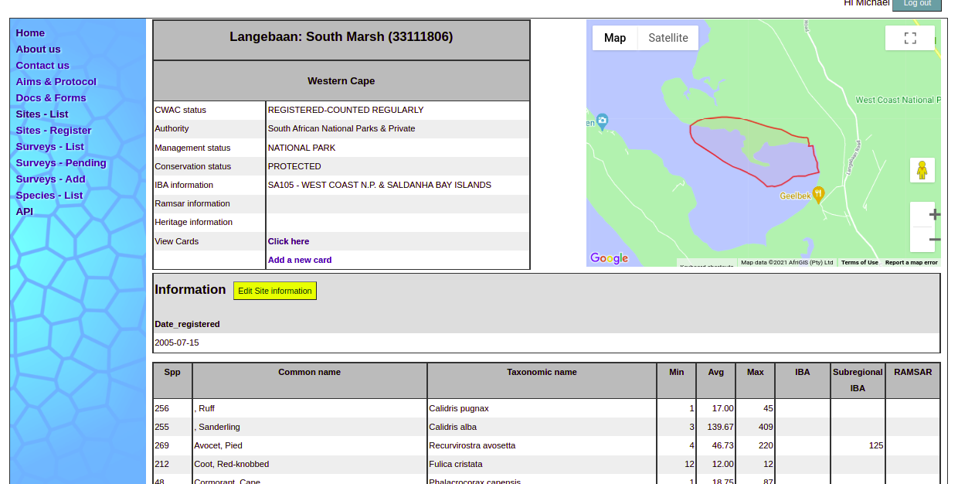
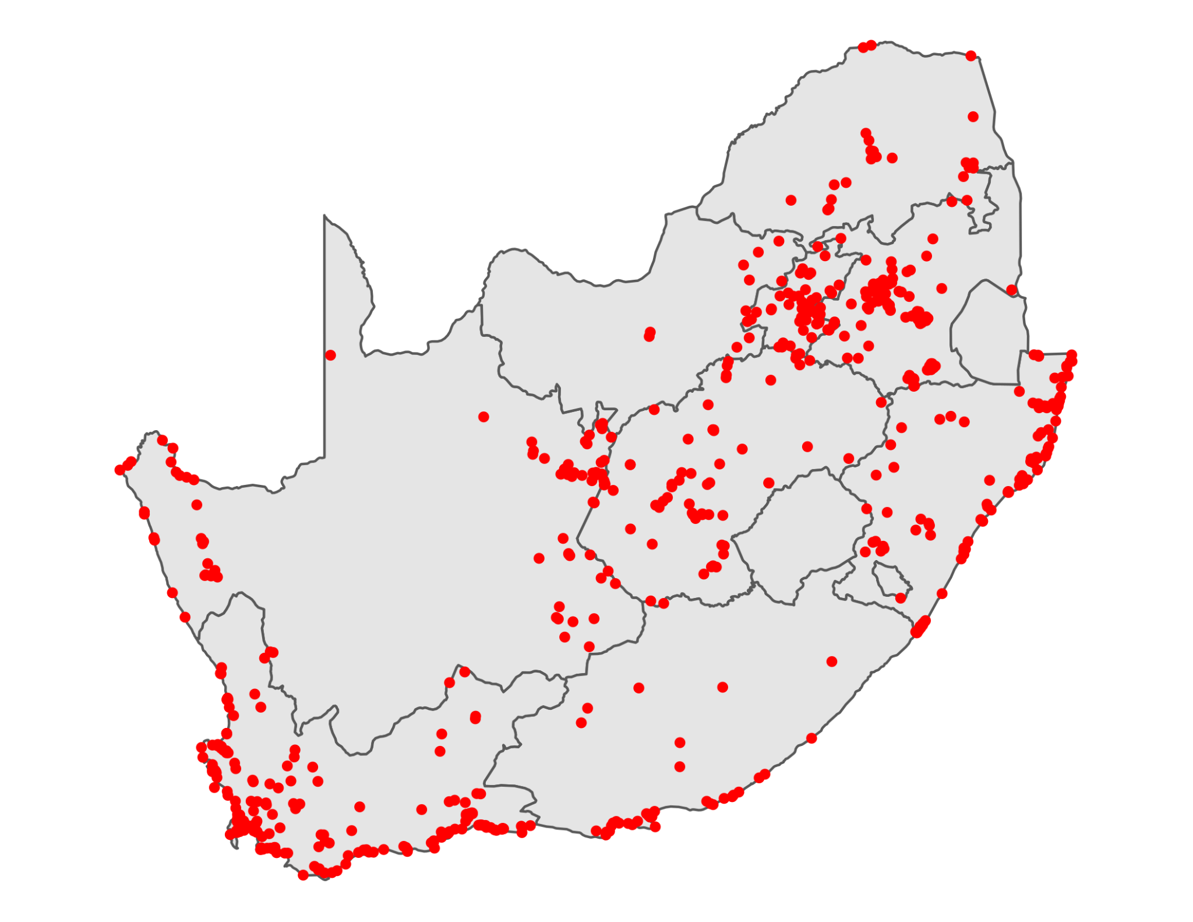
Coordinated Waterbird Counts
1992-ongoing
Abundance
~347,000 records
739 sites

Slide 8
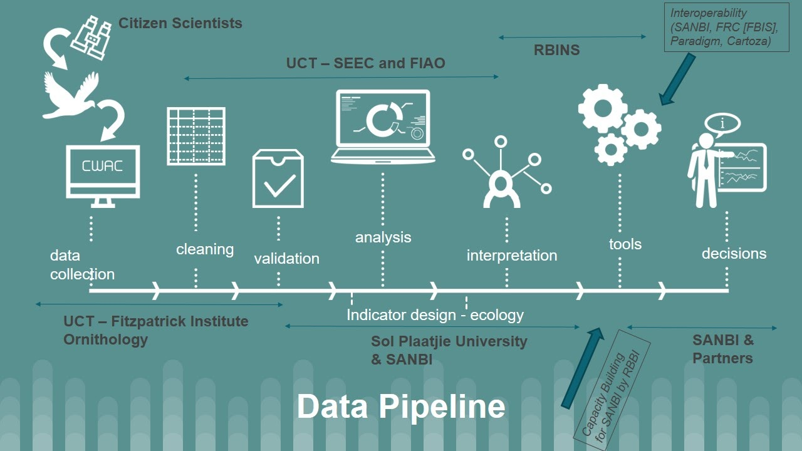
BIRDIE

Slide 9
Who is BIRDIE intended for?
International agreements: Ramsar, AEWA, ...
National programmes: Biodiversity Assessments, Red Listing,...
Site-specific programmes
Researchers
General public: birders, naturalists, …
…

Slide 10
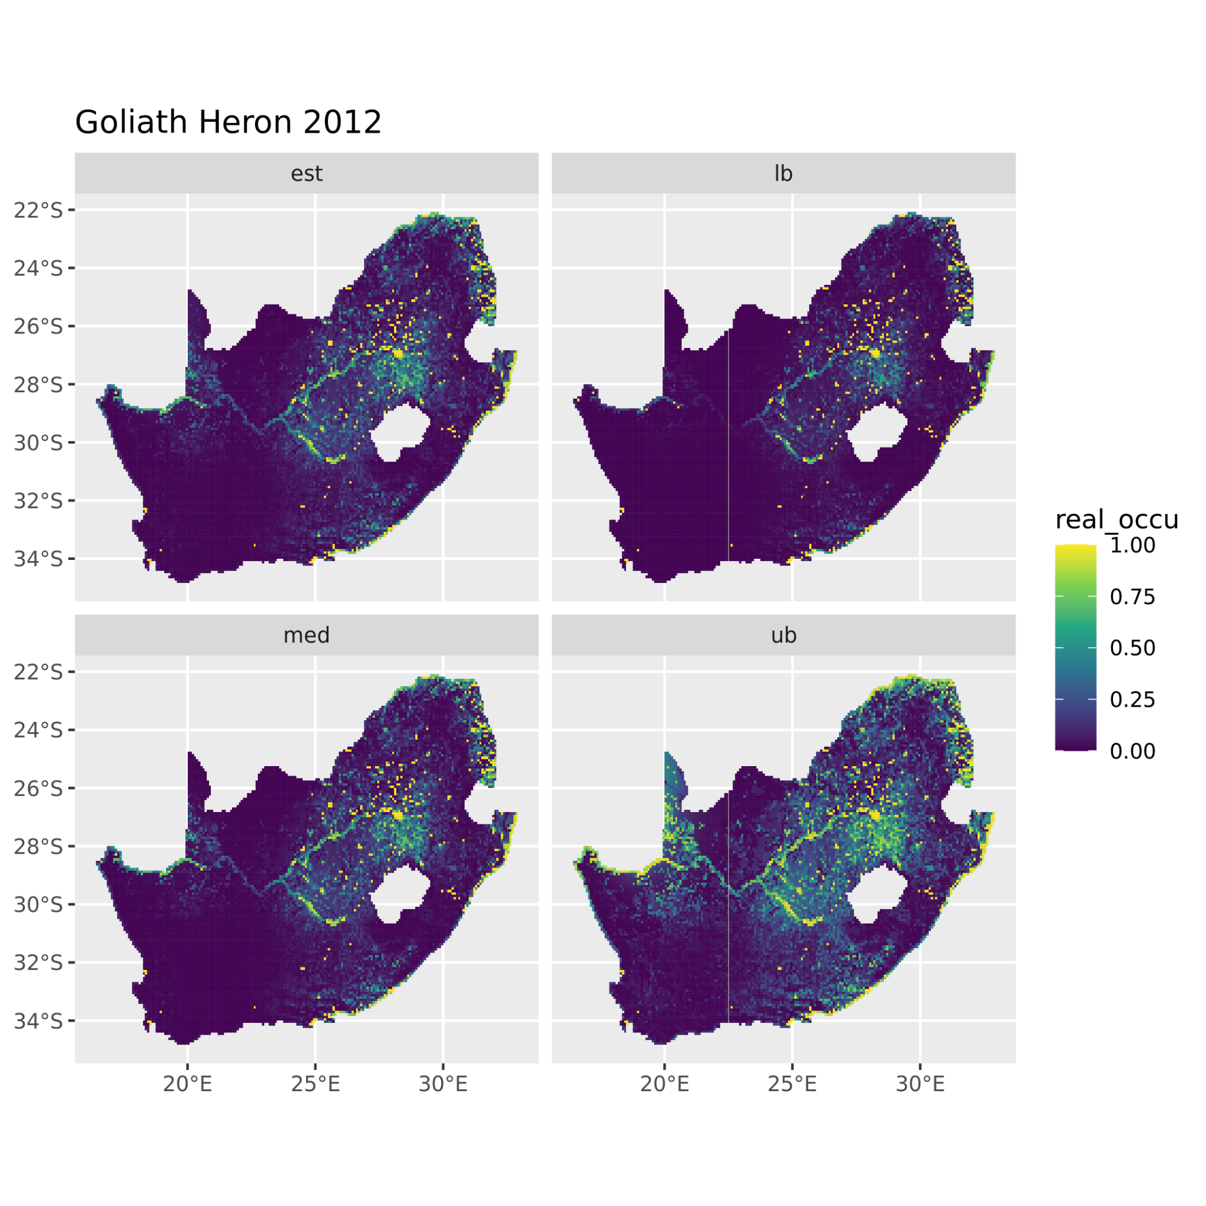
Species distribution
Estimate
Lower bound
Occupancy models for ABAP
Spatio-temporal effects using splines (occuR package*)
Moving three-year window
Derived indicators:
Area of occupancy
Extent occurrence
…
Median
Upper bound
*https://github.com/r-glennie/occuR

Slide 11
Species abundance
State-space model for CWAC
Species- and site- specific models
Aggregate results to obtain abundance at larger scales

Slide 12
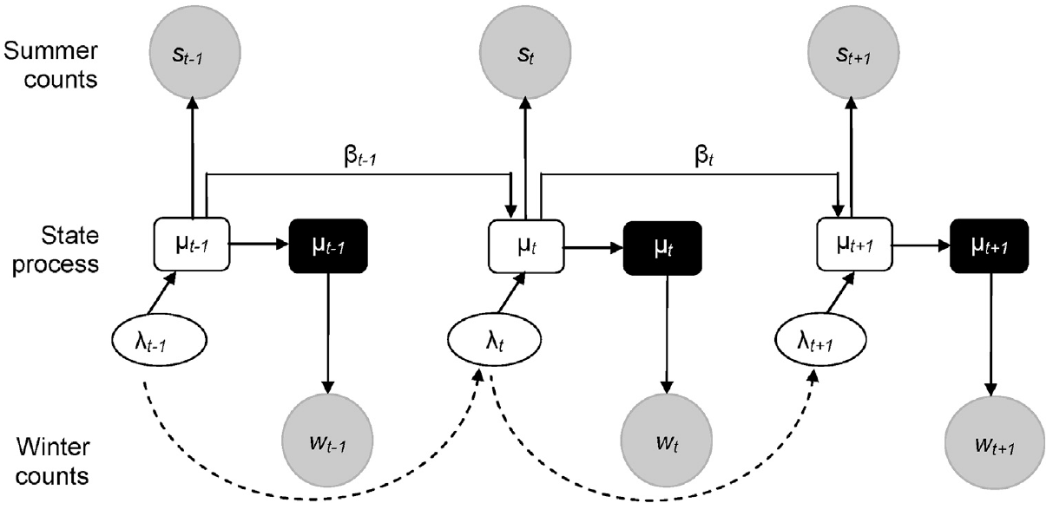
Species abundance
State-space model for CWAC
Species- and site- specific models
Aggregate results to obtain abundance at larger scales
Barshep et al. 2017, Global Eco. and Con. 12

Slide 13
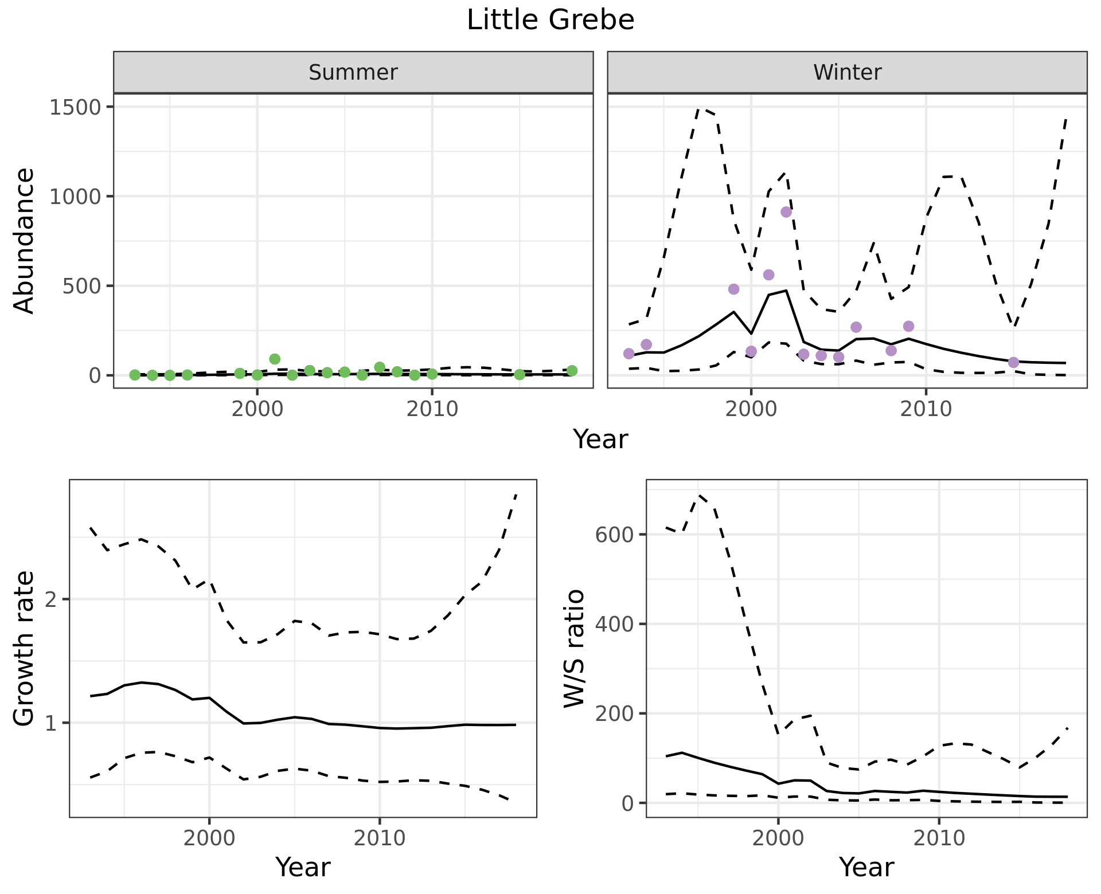
Species abundance
State-space model for CWAC
Species- and site- specific models
Aggregate results to obtain abundance at larger scales
Barshep et al. 2017, Global Eco. and Con. 12

Slide 14

Community diversity
Waterbird Conservation Value (Harebottle et al. 2016, Ostrich 87)
Living Planet Index (see Loh et al. 2005, Phi. Trans. Roy. Soc. 360)
Hill’s numbers (Hill 1973, Ecology 54)
…

Slide 15
Progress and challenges

Slide 16
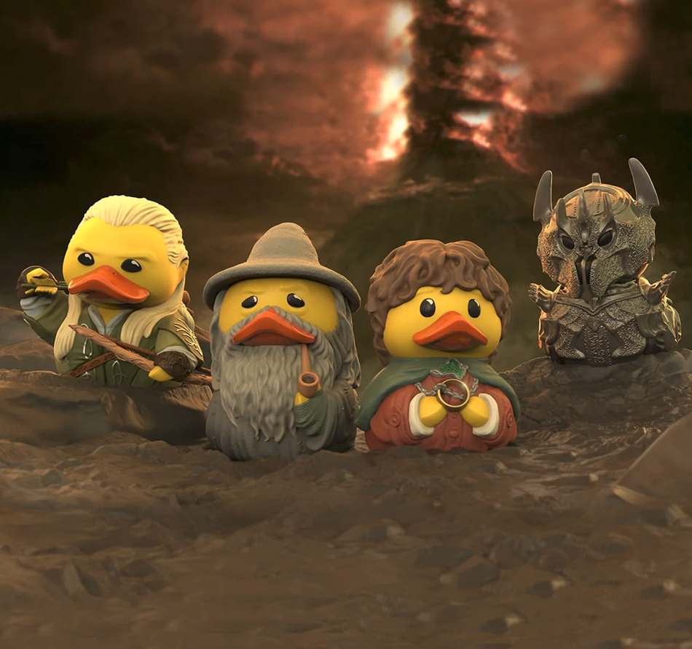
Progress and challenges
“One model” to fit them all

Slide 17

Progress and challenges
“One model” to fit them all
Running time

Slide 18
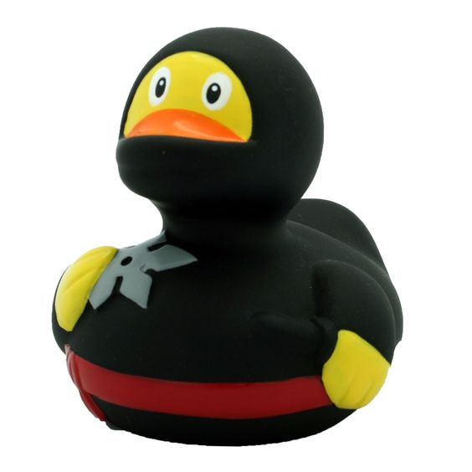
Progress and challenges
“One model” to fit them all
Running time
Species with few detections

Slide 19
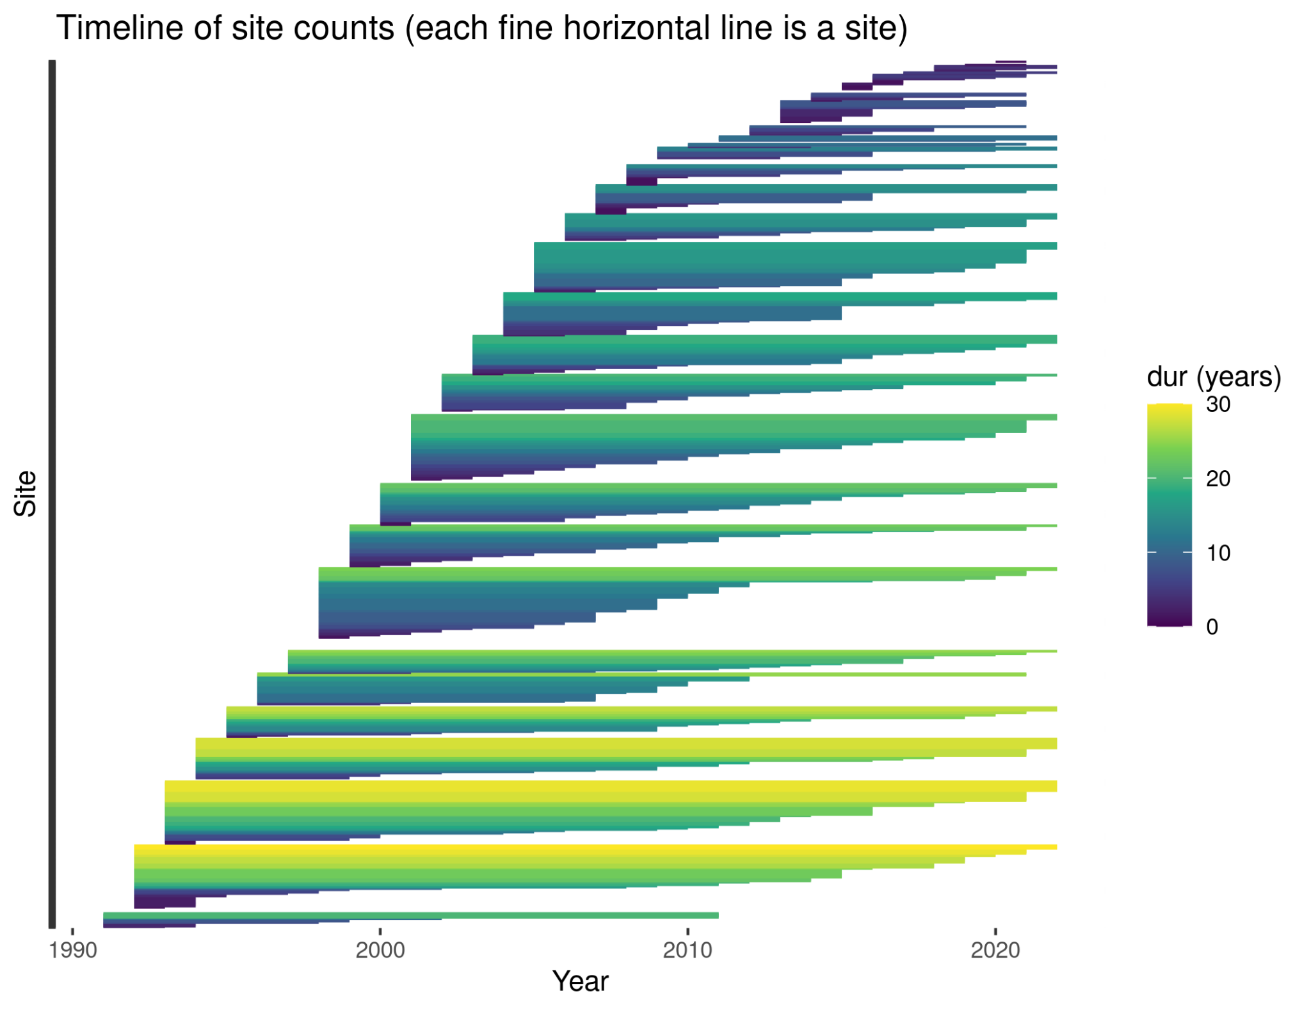
Progress and challenges
“One model” to fit them all
Running time
Species with few detections
Irregular monitoring across sites

Slide 20

Thank you!
Carol Poole (SANBI)
Nancy Job (SANBI)
Andrew Skowno (SANBI)
Sediqa Khatieb (SANBI)
Brenda Daly (SANBI)
Doug Harebottle (Sol Plaatje University)
Michael Brooks (FIAO UCT)
Res Altwegg (SEEC UCT)
Vernon Visser (SEEC UCT)
Francis Strobbe (Seascape Belgium)
Yvan Stojanov (RBINS)
…
f.cervantesperalta@gmail.com

